Slide 1
Performance evaluation of private and public blockchains for multi-cloud service federation
Adam Zahir (UC3M)
Milan Groshev (UC3M)
Kiril Antevski (AXo solutions)
Carlos J. Bernardos (UC3M)
Constantine Ayimba (UC3M)
Antonio de la Oliva (UC3M)

Slide 2
Goal of the work
INVESTIGATE how Public and Private Blockchain platforms affect the negotiation and execution of multi-cloud service federation
SHOWCASE the integration with a production-ready orchestration solution
EVALUATE the performance
RELATED WORK:
- Blockchain-based federation in Dynamic Environments [1]
- Blockchain-based federation for Edge Robotics [2]
[1] Kiril Antevski and Carlos J. Bernardos. “Federation in Dynamic Environments: Can Blockchain Be the Solution?”. IEEE Communications Magazine (2022)
[2] Kiril Antevski, Milan Groshev, Gabriele Baldoni and Carlos J. Bernardos. “DLT federation for Edge robotics”. IEEE NFV-SDN (2020)

Slide 3
Overview
- What is: Federation as a concept
- What is: Blockchain
- Public and Private Blockchains
Experiments & Results
Conclusions and Future Work

Slide 4
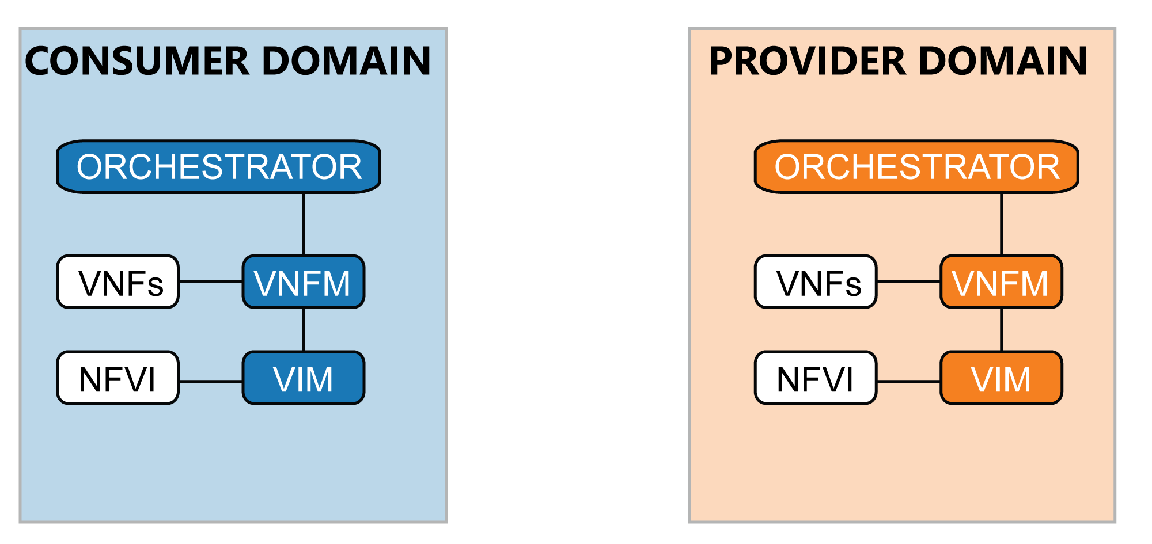
FEDERATION in NFV
FEDERATION
Network Service
E2E Network Service

Slide 5
BLOCKCHAIN
BLOCKCHAIN is a DLT (Distributed Ledger Technology)
Blockchain
- Chain of blocks (filled with transactions)
- CONSENSUS mechanism
- SMART CONTRACTS
Layer 1
Layer 0
Blockchain NETWORK
- P2P network
- Public or private

Slide 6
Public and Private Blockchains
PUBLIC:
Openness: Open participation
Transparency: Public on-chain data
Trade-offs: Slow processing times, limited concurrent ADs
PRIVATE:
Control: Restricted, verified access
Efficiency: Faster consensus
Privacy: Confidential data
Trade-offs: Limited on-chain interactions, potential centralization

Slide 7
Experiments and Results

Slide 8
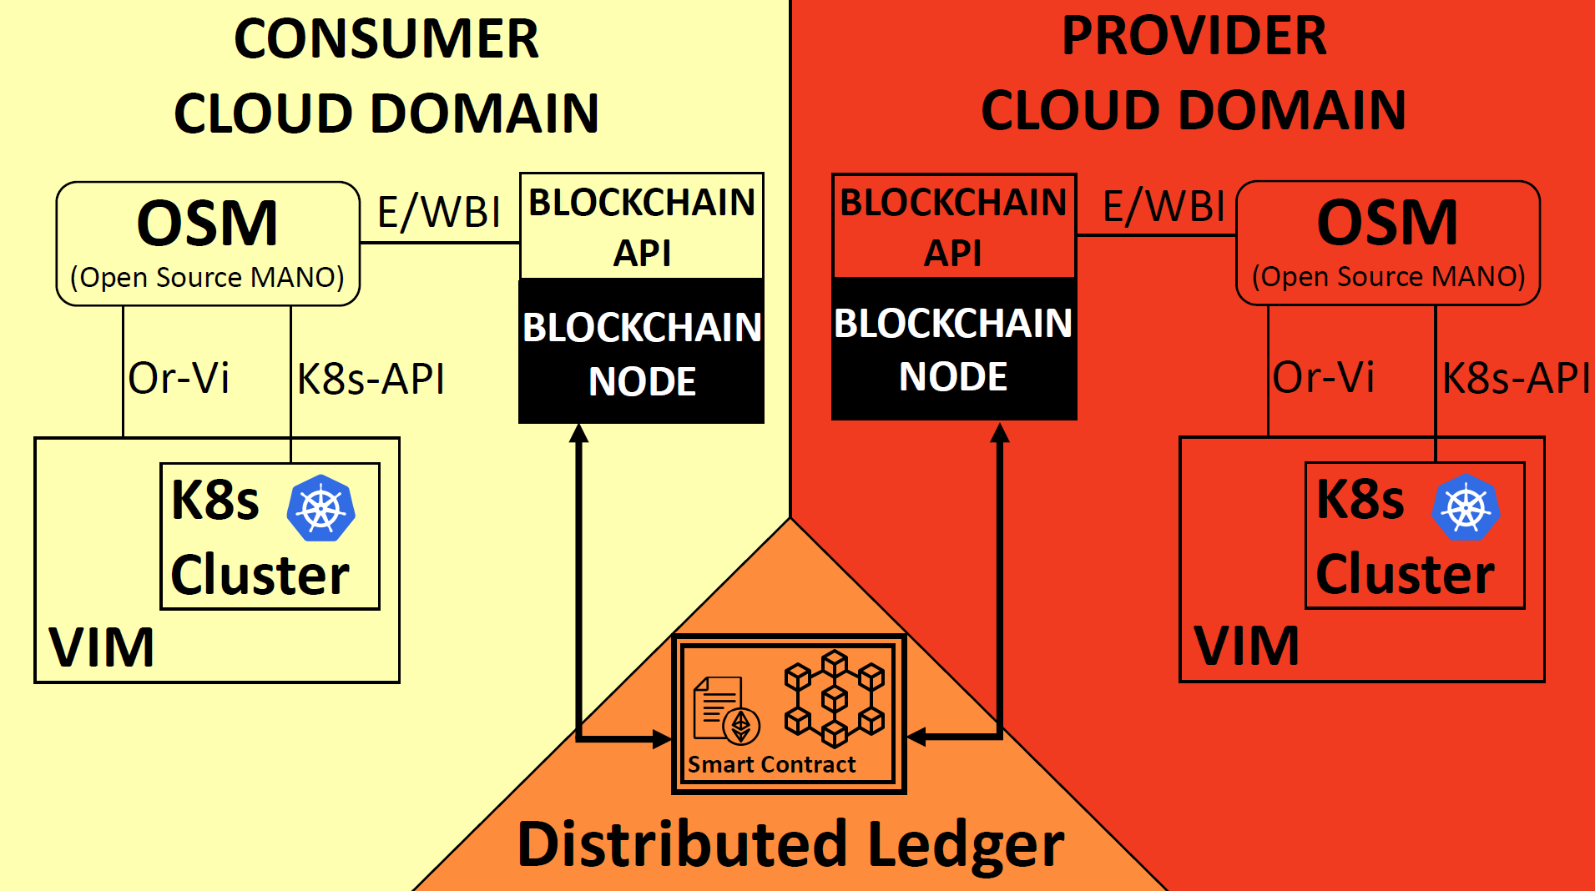
Figure 1: Experimental setup

Slide 9
Consumer
Smart Contract
Provider
Service announced
Announce received
Bid offer sent
Offer received
Winner choosen
Winner received
Service deployed
Confirmation sent
Confirmation received
E2E service running
Figure 2: Sequence diagram of Experimental setup

Slide 10
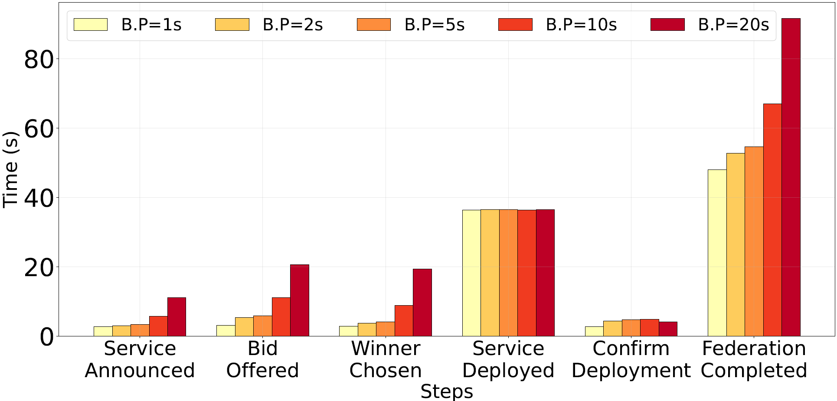
RESULTS
Figure 3: Federation process duration on a Private Blockchain

Slide 11
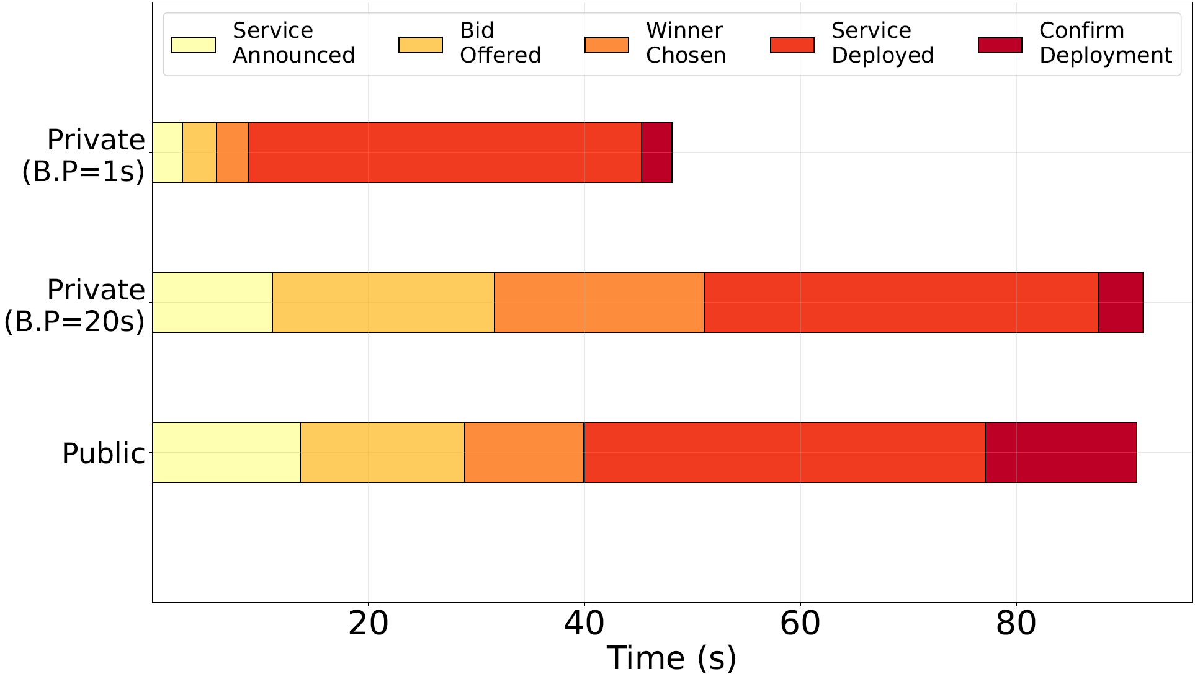
RESULTS
Figure 4: Comparison between the most and least favorable private block periods in relation to the public blockchain

Slide 12
CONCLUSION & FUTURE WORK
First work that conducts a performance analysis of multi-cloud federation using public and private blockchain platforms.
Public Blockchains: Used by everyone for everything, open interface to be integrated with the application
Private Blockchains: Controlled networks, dedicated only to telco entities
- Integration of Blockchain-based federation feature with real-world application
- Expand federation features for Telco operations (e.g., healing, migration)
- Optimize the OSM Blockchain-federation deployment time

Slide 13



Acknowledgements
This work has been partly funded by the European Commission Horizon Europe SNS JU DESIRE6G project (grant no. 101096466),
and the Spanish Ministry of Economic Affairs and Digital Transformation and the European Union-NextGenerationEU through the UNICO 5G I+D 6G-EDGEDT and 6G-DATADRIVEN

Slide 14
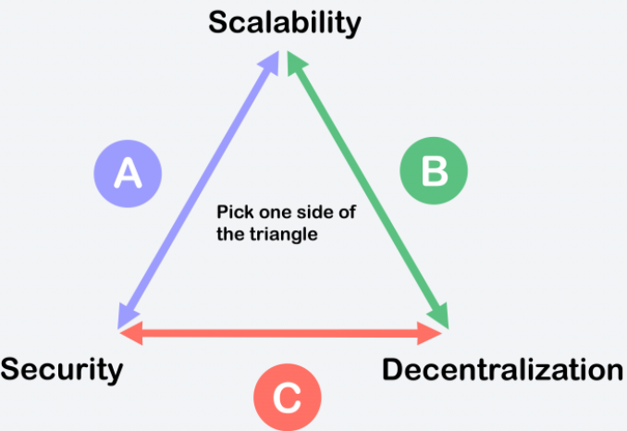
Security and Scalability in blockchain technology
SECURITY and SCALABILITY issues are primarily related to the consensus protocol
BLOCKCHAIN TRILEMMA: high scalability and decentralization but weak security vs
high decentralization and security but weak scalability

Slide 15
Service Deployment time
ISSUE: Long OSM instantiation time in federated services
PROPOSED STRATEGY: Pre-deployment of services by provider domains, enabling direct consumer access upon federation agreement

